Slide 1
Lecture 13- Natural Language Processing
Hamed Hasheminia

Slide 2
Agenda
What is Natural Language Processing?
NLP Applications
Basic NLP Practice

Slide 3
Natural Language Processing
The interface between human and computer language
Natural language processing is the task of extracting meaning and information from text documents.
These tasks may range from simple classification tasks, such as deciding what category a piece of text falls into, to more complex tasks like translating or summarizing text.
Can you come up with some real-world examples of NLP? (I think some of you are already using it!)

Slide 4
How do we teach computers to understand human language?
How do we discern the meaning of sea in the following sentences?
“The driftwood floated in from the sea”
My cousin is dealing with a sea of troubles.”
Large body of water: the sea
Figurative large quantity sea of

Slide 5

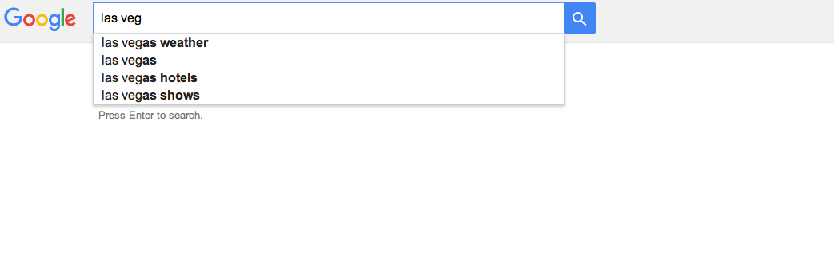
NLP Applications
Speech Recognition
Machine Translation
Auto Correction
Sentiment analysis
Topic Modeling

Slide 6
Tokenization
Tokenization is the task of separating a sentence into its constituent parts, or tokens.
Determining the “words” of a sentence seems easy but can quickly become complicated with unusual punctuation (common in social media) or different language conventions.
What sort of difficulties may there be with the following sentence?
The L.A. Lakers won the NBA championship in 2010, defeating the Boston Celtics.

Slide 7
Tokenization Examples
My house is located in Uptown. → [My, house, is, located, in, Uptown]
The Lakers are my favorite team. → [The, Lakers, are, my, favorite, team]
Data Science is the future! → [Data, Science, is, the, future]
GA has many locations. → [GA, has, many, locations.]

Slide 8
Lemmatization and Stemming
Lemmatization is a more refined process that uses specific language and grammar rules to derive the root of a word.
This is useful for words that do not share an obvious root such as ‘better’ and ‘best’.
What are some other examples of words that do not share an obvious root?

Slide 9
Lemmatization and Stemming
Lemmatization
shouted → shout
best → good
better → good
good → good
Stemming
badly → bad
computing → comput
computed → comput

Slide 10
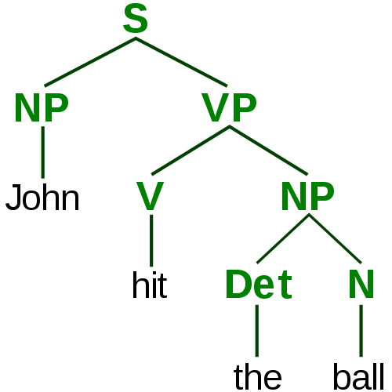
Parsing/Tagging Trees

Slide 11
Stop Words
Some words are so common that they provide no information to a statistical language model.
Here are some examples of stop words “the, in, a, ….”
We should remove these stop words.

Slide 12
Text Classification
Text classification is the task of predicting what category or topic a piece of text is from.
For example, we may want to identify whether an article is a sports or business story. Or whether has positive or negative sentiment.
Typically, this is done by using the text as features and the label as the target output. This is referred to as bag-of-words classification.
To include text as features, we usually create a binary feature for each word, i.e. does this piece of text contain that word?

Slide 13
Text Classification
To create binary text features, we first create a vocabulary to account for all possible words in our universe.
As we do this, we need to consider several things.
Does order of words matter?
Does punctuation matter?
Does upper or lower case matter?

Slide 14
Text Classification
“It’s a great advantage not to drink among hard drinking people.”
Feature | Value
it’s | 1
great | 1
good | 0
advantage | 1
not | 1
think | 0
drink | 1
from | 0
hard | 1
drinking | 1
Feature | Value
people | 1
withhold | 0
random | 0
smoke | 0
among | 1
whenever | 0
thoughtful | 0
inexhaustible | 0
men | 0
Nick | 0

Slide 15
Regularizing the models
REMEMBER: Using all of the words can be useful, but we may need to use regularization to avoid overfitting. Otherwise, rare words may cause the model to overfit and not generalize.
We can use CV and Lasso/Ridge type of modification to regularize our models.
A better way to lower the high dimension of our input data is using Principle Component Method.

Slide 16
Term Frequency – Inverse Document Frequency
TF-IDF uses the product of two intermediate values, the Term Frequency and Inverse Document Frequency.
Term Frequency is just the number of times a word appears in the document (i.e. count).
Document Frequency is the percentage of documents that a particular word appears in.
For example, “the” would be 100% while “Syria” is much lower.
Inverse Document Frequency is just 1/Document Frequency.

Slide 17
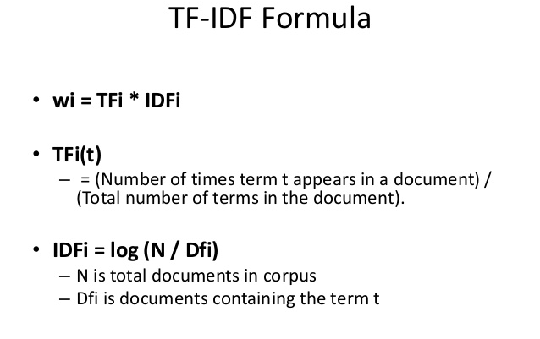
TF-IDF

Slide 18
TF-IDF
The intuition is that the words that have high weight are those that either appear frequently in this document or appear rarely in other documents (and are therefore unique to this document).
This is a good alternative to using a static set of stop words.

Slide 19
Summary
We learned about Natural Language Processing
Tokenization/Lemmatization/Stemming
Parsing and tagging trees
Stop Words
Bag-of-Words
TF-IDF

